Slide 1
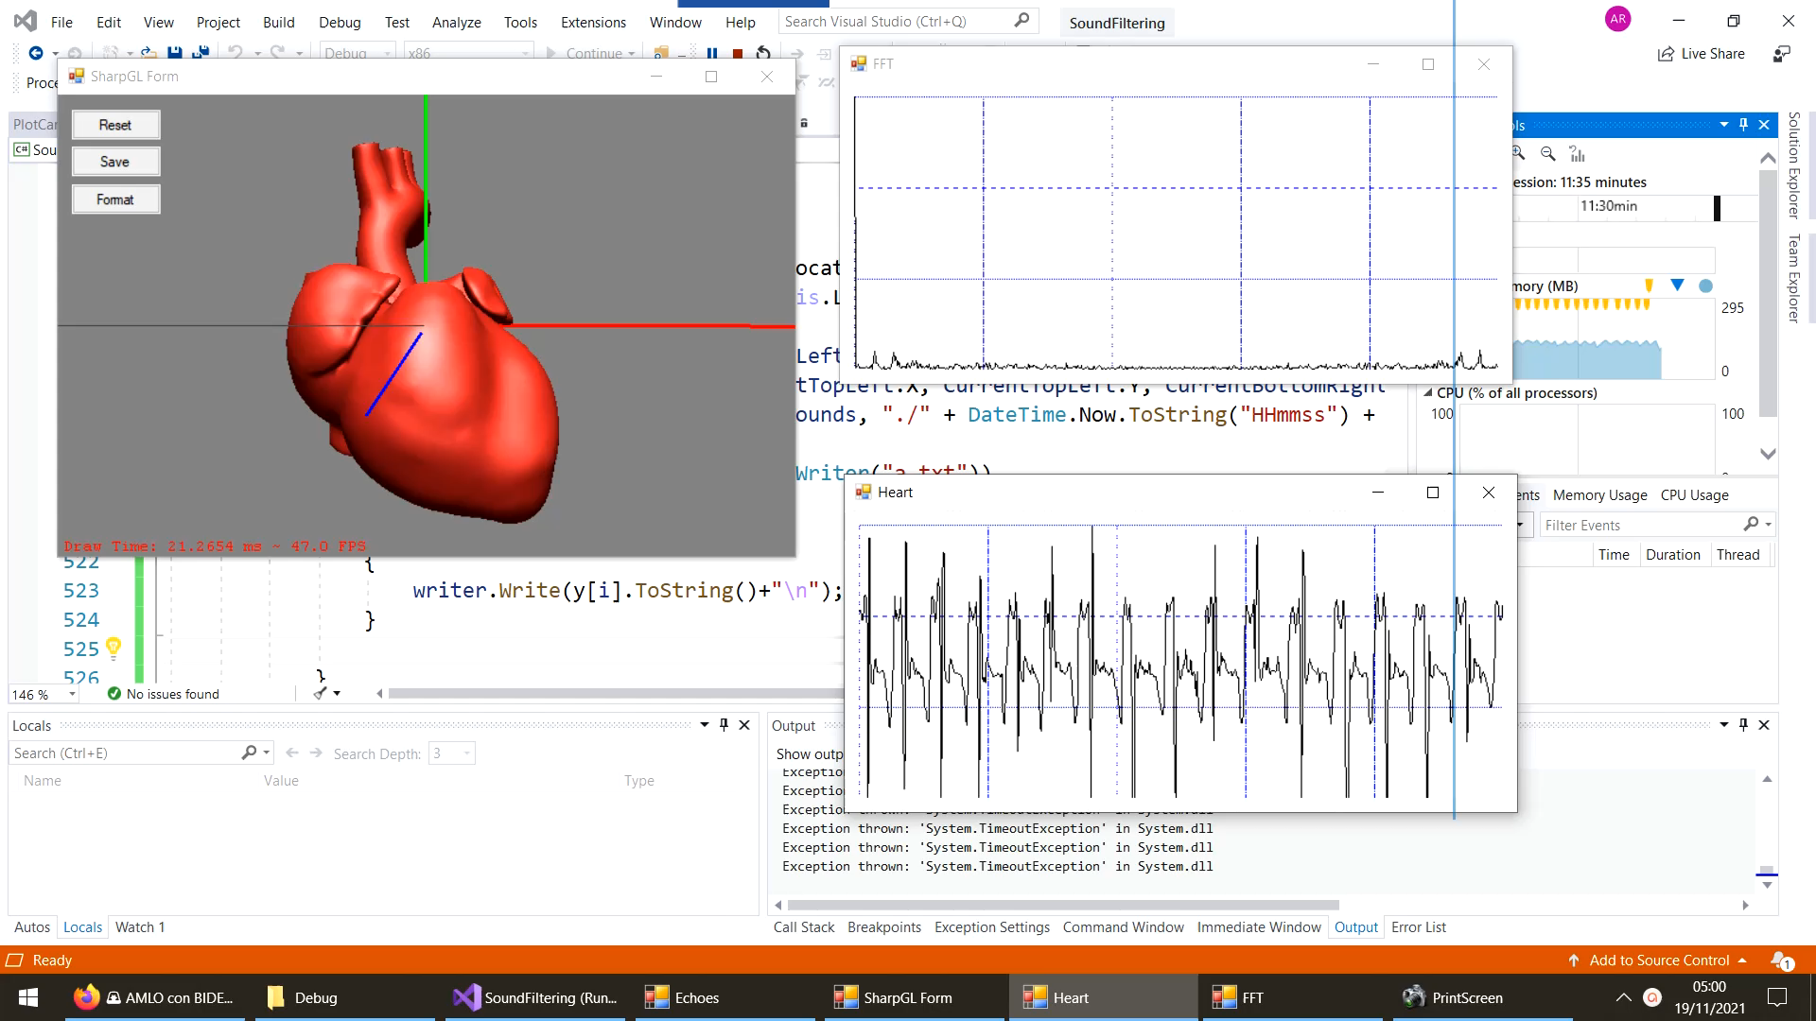
Peak Detection

Slide 2
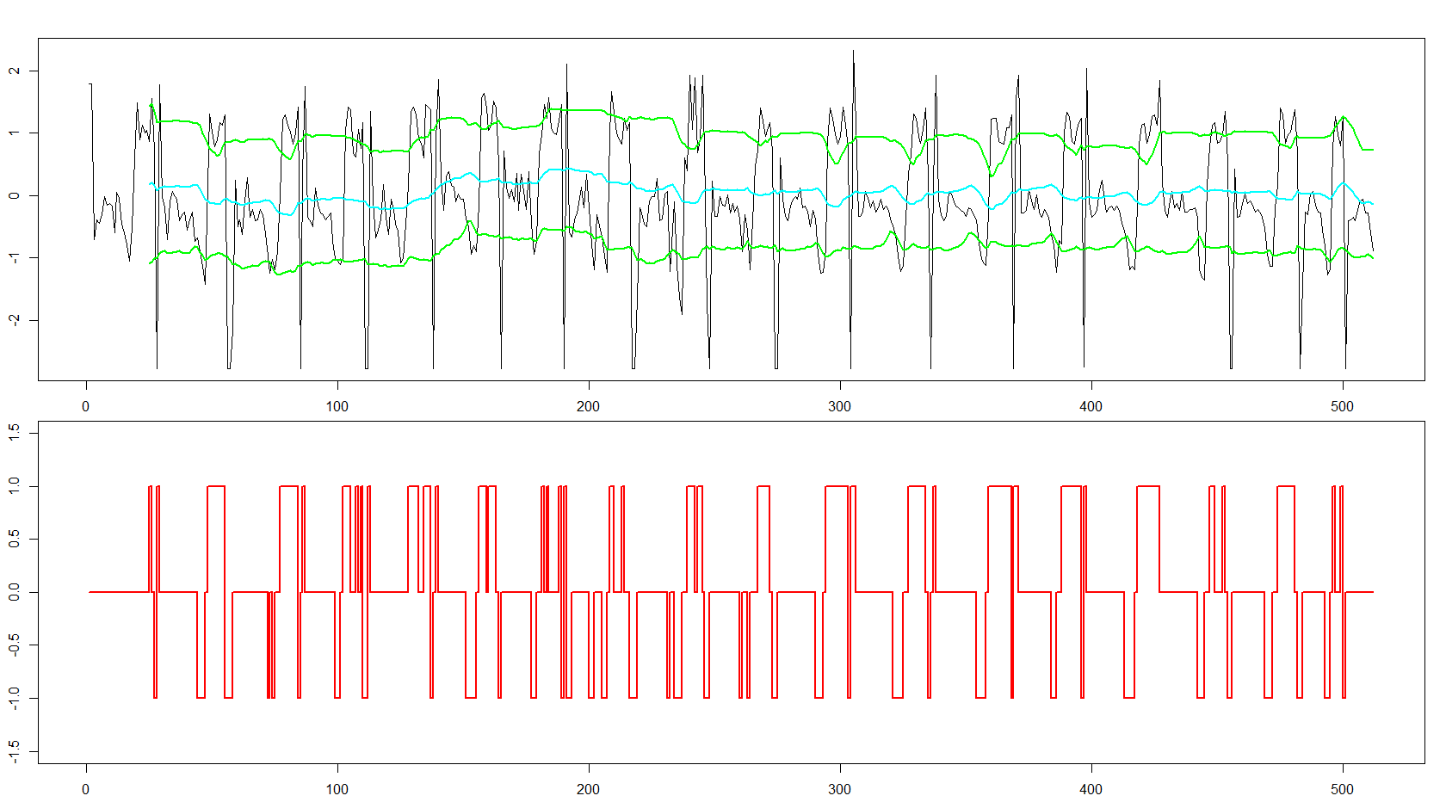
lag <- 25
threshold <- 1.5
influence <- 0.3

Slide 3
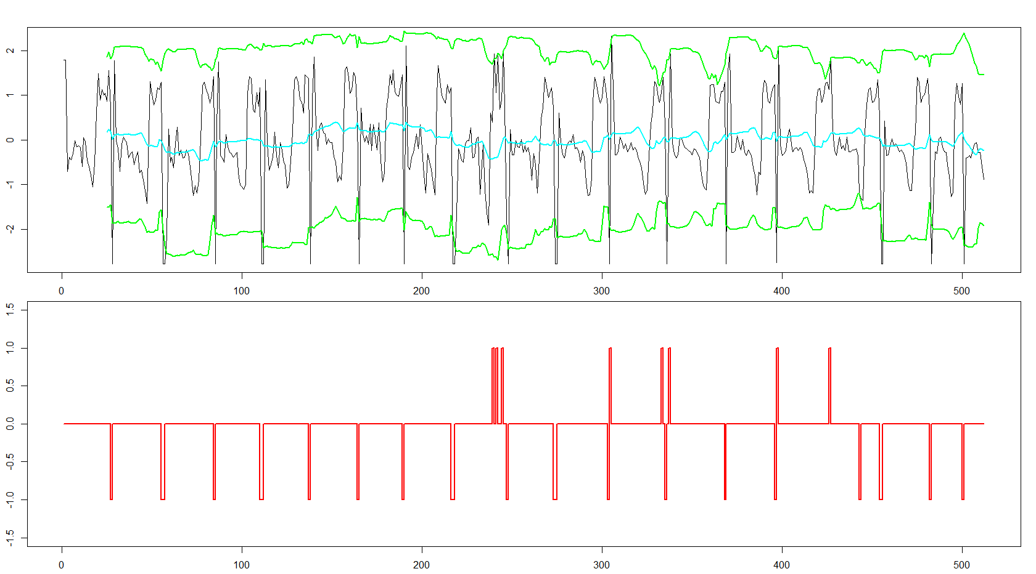
lag <- 25
threshold <- 2
influence <- 1

Slide 4
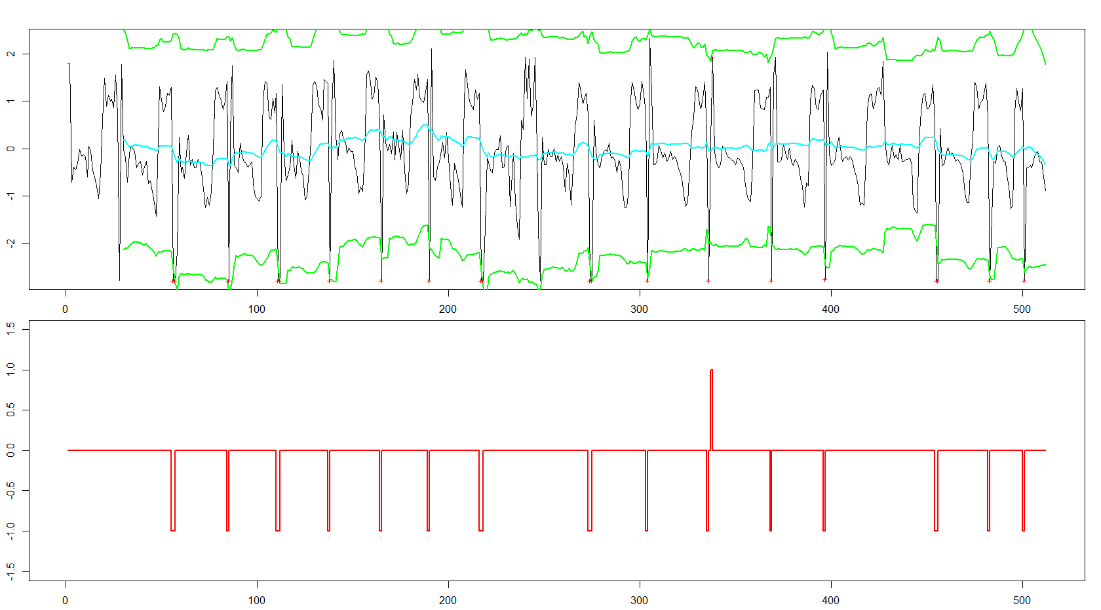
lag <- 30
threshold <- 2.5
influence <- 1

Slide 5
Robust peak detection algorithm using z-scores
lag = the lag of the moving window
threshold = the z-score at which the algorithm signals
influence = the influence (between 0 and 1) of new signals on the mean and standard deviation
Brakel, J.P.G. van (2014). "Robust peak detection algorithm using z-scores"(version: 2020-11-08).

